Slide 1
Pizza Sales Analysis (With SQL)
Crust to Crumbs: Exploring Pizza Sales Data, Unveiling Sales Insights & Trends
Presented By- Binoy Patra

Slide 2
CONTENTS
01 Introduction
02 Objective
03 Dataset Overview
04 Key Findings
05 Pizza Analysis Summary
Size-wise,Type-Wise and Category-wise Summary
06 Time Based Summary
Hourly, Weekday,Monthly Order
Summary
07 Conclussion
08 Reccomendfation
© 2024 Binoy Patra. All Rights Reserved

Slide 3
01. Introduction
In the dynamic and competitive landscape of the food industry, understanding
customer preferences and revenue drivers is crucial for maximizing profitability
and maintaining a competitive edge.
This project delves into the realm of pizza sales analysis, leveraging a
comprehensive dataset encompassing orders, pizza types, ingredients, sizes, and
pricing.
By scrutinizing this wealth of information, we aim to uncover valuable insights tha
illuminate patterns in customer behavior and operational efficiency.
Armed with these insights, businesses can make informed decisions to tailor menus,
optimize pricing strategies, and streamline operations, ultimately enhancing
customer satisfaction and profitability in the fiercely competitive pizza market.
© 2024 Binoy Patra. All Rights Reserved

Slide 4
02. Objective
Gain deep insights into customer preferences for pizza types, sizes, and categories.
Identify key revenue drivers and understand their impact on overall profitability.
Explore trends in order patterns by day, hour, and month to inform operational
strategies.
Recommend data-driven approaches for menu optimization, pricing strategies, and
operational efficiency improvements.
Provide actionable insights that enable businesses to maximize profitability, delight
customers, and maintain a competitive advantage in the pizza market.
© 2024 Binoy Patra. All Rights Reserved

Slide 5
03. Dataset Overview
The dataset for this project comprises four interconnected tables:
orders, pizza_types, order_details, and pizzas_price.
The dataset's structure is designed to capture a comprehensive view of the pizza ordering process:
The orders table records the overarching details of each order, such as the date and
time.
The pizza_types table details the various pizzas offered, including their names,
categories, and ingredients.
The order_details table provides a breakdown of each order, specifying the types and quantities of pizzas ordered.
The pizzas_price table links each pizza type to its size and price, enabling detailed
financial analysis.
© 2024 Binoy Patra. All Rights Reserved

Slide 6
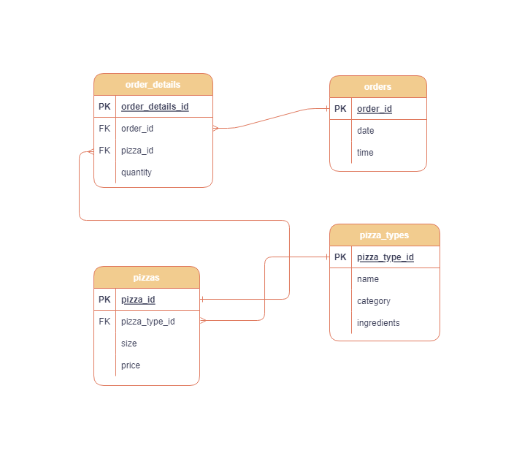
03. Dataset Overview
Data Model and Relationships:
© 2024 Binoy Patra. All Rights Reserved

Slide 7
04. Key Findings
Total Orders : 21350
Total Revenue : $817860.05
Total Pizza Quantity Sold : 49574
Average Order Quantity (per tranaction) : 2.32
Average Order Amount (per tranaction) : $38
Unique Pizza Types : 32
Unique Pizza Sizes : 5 (S-Small, M-Medium,L-Large, XL- Extra Large, XXL: Double Extra Large)
Unique Pizza Categories : 4 (Chicken, Classic, Supreme, Veggie)
Category-wise distribution of pizzas:
Supreme: 9 Types
Veggie: 9 Types
Classic: 8 Types
Chicken: 6 Types
10. Highest Priced Pizza: The Greek Pizza, $35.95
11. Lowest Priced Pizza: The Pepperoni Pizza, $9.75
12. Average Quantity Sold Per Day: 138
13. Average Revenue Per Day: $2285
© 2024 Binoy Patra. All Rights Reserved

Slide 8
Pizza Size-wise Summary
Pizza_Size | Total_Order | Total_Quantity | Revenue
L | 18526 | 18956 | 375319
M | 15385 | 15635 | 249382
S | 14137 | 14403 | 178076
XL | 544 | 552 | 14076
XXL | 28 | 28 | 1007
Insights:
1. The Large (L) pizzas dominate the sales, contributing
45.9% to the total revenue, with 18,526 orders and
generating $375,319.
2. Medium (M) pizzas follow, with 30.5% revenue
contribution and 15,385 orders.
3. Small (S) pizzas also make a significant impact with 21.8% of total revenue from 14,137 orders.
4. Extra Large (XL) and Double Extra Large (XXL) pizzas have minimal contributions, with a combined revenue share of only 1.8%.
This suggests a strong customer preference for larger-sized
pizzas.
Pizza_Size | Size_wise_Revenue | Total_Revenue | Percent_Contribution(%)
L | 375318.7 | 817860 | 45.9
M | 249382.2 | 817860 | 30.5
S | 178076.5 | 817860 | 21.8
XL | 14076 | 817860 | 1.7
XXL | 1006.6 | 817860 | 0.1
© 2024 Binoy Patra. All Rights Reserved

Slide 9
Pizza Category-wise Summary
Pizza_Category | Total_Order | Total_Quantity | Revenue
Classic | 10859 | 14888 | 220053
Supreme | 9085 | 11987 | 208197
Chicken | 8536 | 11050 | 195920
Veggie | 8941 | 11649 | 193690
Insights:
1. The Classic category leads both in terms of
total orders (10,859) and revenue
(220,053.1 Rupees), contributing the
highest percentage (26.9%) to the total
revenue.
2. Supreme pizzas follow, with 9,085 orders and 208,197 Rupees in revenue, contributing
25.5% to the total revenue.
3. Chicken pizzas come next, with 8,536 orders
generating 195,919.5 Rupees in revenue,
accounting for 24% of the total revenue.
4. The Veggie category has 8,941 orders and
generates 193,690.5 Rupees in revenue,
contributing 23.7% to the total revenue.
Pizza_Category | Category_wise_Revenue | Total_Revenue | Percent_Contribution (%)
Classic | 220053.1 | 817860.1 | 26.9
Supreme | 208197 | 817860.1 | 25.5
Chicken | 195919.5 | 817860.1 | 24
Veggie | 193690.5 | 817860.1 | 23.7
© 2024 Binoy Patra. All Rights Reserved

Slide 10
Pizza Type-wise Summary
Insights:
1. The Thai Chicken Pizza leads in revenue, generating $43,434 from
2,315 orders, followed closely by the Barbecue Chicken Pizza with $42,768 from 2,372 orders.
2. Popular choices such as the California Chicken Pizza and the Classic Deluxe Pizza also show strong performance with revenues of
$41,410 and $38,180, respectively.
3. Conversely, pizzas like the Brie Carre Pizza, despite their unique
offerings, contribute the least to overall revenue, suggesting a
clear preference for specific popular varieties among customers.
Pizza_Type | Total_ORDER | Total_Quantity | Revenue
Top 5
The Thai Chicken Pizza | 2315 | 2371 | 43434
The Barbecue Chicken Pizza | 2372 | 2432 | 42768
The California Chicken Pizza | 2302 | 2370 | 41410
The Classic Deluxe Pizza | 2416 | 2453 | 38180
The Spicy Italian Pizza | 1887 | 1924 | 34831
Bottom 5
The Spinach Pesto Pizza | 957 | 970 | 15596
The Mediterranean Pizza | 923 | 934 | 15360
The Spinach Supreme Pizza | 940 | 950 | 15278
The Green Garden Pizza | 987 | 997 | 13956
The Brie Carre Pizza | 480 | 490 | 11588
© 2024 Binoy Patra. All Rights Reserved

Slide 11
Hourly Order Summary
Hour | Number_of_Order
9 | 1
10 | 8
11 | 1231
12 | 2520
13 | 2455
14 | 1472
15 | 1468
16 | 1920
17 | 2336
18 | 2399
19 | 2009
20 | 1642
21 | 1198
22 | 663
23 | 28
Insights:
1. Peak ordering hours are from 11 AM to 1 PM, with a sharp increase, reaching the
highest at 12 PM with 2520 orders.
2. There is another significant rise from 5 PM to 6 PM with 2399 orders at 6 PM, likely due to dinner time.
3. Minimal orders are observed early in the morning (9 AM to 10 AM) and late at
night (10 PM to 11 PM).
© 2024 Binoy Patra. All Rights Reserved

Slide 12
Monthly Order Summary
Months | Number_of_Order
January | 1845
February | 1685
March | 1840
April | 1799
May | 1853
June | 1773
July | 1935
August | 1841
September | 1661
October | 1646
November | 1792
December | 1680
Insights:
1. The orders are relatively consistent throughout the year, with slight peaks in July (1935 orders) and May (1853 orders).
2. September (1661 orders) and October (1646 orders) had the lowest
number of orders, suggesting a potential seasonal dip.
© 2024 Binoy Patra. All Rights Reserved

Slide 13
Weekday Order Summary
Days | Number_of_Order
Sunday | 2624
Monday | 2794
Tuesday | 2973
Wednesday | 3024
Saturday | 3158
Thursday | 3239
Friday | 3538
Insights:
1. Friday (3538 orders) and Thursday (3239 orders) see the highest number of orders, indicating a trend towards increased end-of-week dining.
2. Saturday (3158 orders) and Wednesday (3024 orders) also show strong
order volumes.
3. The least orders are placed on Sunday (2624 orders), suggesting lower
demand at the start of the week.
© 2024 Binoy Patra. All Rights Reserved

Slide 14
Best 3 Pizza of Each Category
Pizza_Category | Pizza_Name | Revenue | Ranking
Chicken | The Thai Chicken Pizza | 43434 | 1
Chicken | The Barbecue Chicken Pizza | 42768 | 2
Chicken | The California Chicken Pizza | 41410 | 3
Classic | The Classic Deluxe Pizza | 38180 | 1
Classic | The Hawaiian Pizza | 32273 | 2
Classic | The Pepperoni Pizza | 30162 | 3
Supreme | The Spicy Italian Pizza | 34831 | 1
Supreme | The Italian Supreme Pizza | 33477 | 2
Supreme | The Sicilian Pizza | 30940 | 3
Veggie | The Four Cheese Pizza | 32266 | 1
Veggie | The Mexicana Pizza | 26781 | 2
Veggie | The Five Cheese Pizza | 26066 | 3
Insights:
The Thai Chicken Pizza, Classic Deluxe Pizza, Spicy Italian
Pizza, and Four Cheese Pizza lead their respective
categories in revenue, showcasing customer preferences for both unique and traditional flavors.
Each category's top three pizzas significantly contribute
to overall sales, highlighting key products that drive business success.
© 2024 Binoy Patra. All Rights Reserved

Slide 15
07. Conclussion
Our comprehensive pizza sales analysis reveals critical insights into customer preferences and
revenue drivers.
1. Large pizzas dominate the market, contributing 45.9% to the total revenue, followed by
medium and small sizes.
2. Popular pizza types like the Thai Chicken, Classic Deluxe, and Spicy Italian generate the highest
revenues, reflecting strong customer preferences for specific flavors.
3. Weekday analysis indicates Friday as the peak day for orders, while noon to early afternoon
(11 AM - 1 PM) sees the highest order volume.
4. Category-wise, Classic pizzas lead in sales, closely followed by Supreme and Chicken pizzas.
Understanding these trends allows us to optimize our menu, pricing, and marketing strategies,
ultimately enhancing customer satisfaction and maximizing profitability.
© 2024 Binoy Patra. All Rights Reserved

Slide 16
08. Reccomendations
1. Menu Optimization:
Promote top-selling pizzas like Thai Chicken, Classic Deluxe, and Spicy Italian to maximize revenue.
Expand the variety of large-sized pizzas to cater to customer preferences and increase sales volume.
2. Marketing Enhancements:
Increase marketing efforts during peak times (noon to early afternoon) and high-traffic days (especially Fridays) to capitalize on demand surges.
Implement targeted promotions and discounts mid-week to stimulate sales on slower days.
3. Pricing Strategy:
Evaluate pricing strategies for top-performing pizzas, considering modest increases to leverage their popularity while maintaining customer satisfaction.
Introduce bundle deals or meal combinations featuring popular pizzas to encourage larger transactions.
© 2024 Binoy Patra. All Rights Reserved

Slide 17
08. Reccomendations
4. Customer Engagement:
Launch loyalty programs or rewards focused on frequent buyers of popular pizza categories (e.g., Classic, Supreme, Chicken) to foster customer loyalty.
Solicit customer feedback on favored pizzas to innovate and introduce new variants or
limited-time offers based on preferences.
5. Operational Efficiency:
Optimize operational workflows during peak hours with adequate staffing and streamlined processes to handle high order volumes effectively.
Explore advanced order options or reservations to manage peak periods efficiently and enhance overall customer experience.
© 2024 Binoy Patra. All Rights Reserved

Slide 18
THANK YOU
Dataset Credit: Maven Analytics
LinkedIn: Binoy Patra
GitHub: Binoy Patra
Special Thanks: Ayushi Jain
© 2024 Binoy Patra. All Rights Reserved

